Slide 1
Financing anti-malaria efforts in Asia
Urban Weber, PhD
APLMA Regional Financing for Malaria Taskforce
Hong Kong, 12 May 2014

Slide 2
Epidemiology & Trends (WHO)
Positive trend throughout (conventional malaria)
Where decrease in incidence >75%, there also high coverage with interventions (ITNs or IRS covering >50% of population at risk)
 | 2000 | 2012 | 2015
People at risk |  | 2.3b
People at high risk |  | 1.0b
Confirmed cases | 3.3m | 2.3m
Confirmed deaths | 7.900 | 1.660
Case redux. >75% (of 20 countries) |  | 13 | 3
Notes:
Less than 75% decrease expected: India, Indonesia, Myanmar, Papua New Guinea

Slide 3
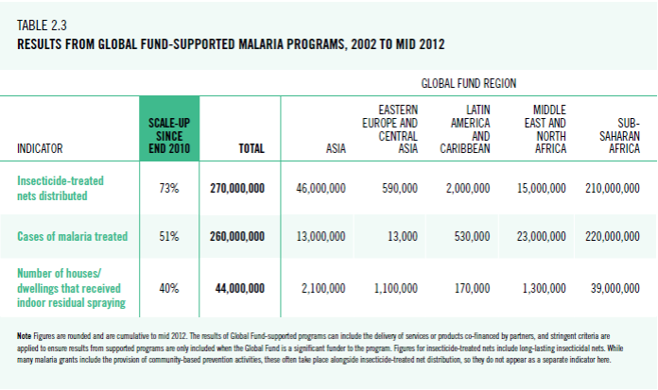
Global Fund Results 2002-2012
GF – Important contribution to national efforts
Notes:
Asia – 46m LLINs, 13m cases treated, 2.1m houses sprayed
% of global: LLIN=17; Tx=5; IRS=5 → relative to population, very manageable figures overall

Slide 4
GF Malaria Asia 2003-13-17 ($m)
Steady Increase 2003-2010
Stable at high level since then
1.170$m (2003-13) plus 649$m (2014-17) = 1.819$m
Next replenishment: Increase unlikely; best case = flat
Notes:
Global malaria 2003-2013 = 6.400m$ (so Asia = 18% of global)
Global Fund = 60% of international funding to fight malaria
Trend line: 3-years moving average

Slide 5
Malaria: GF per country; $m
2014-17: most countries flat relative to last 4 years
2003-09: 490$m
2010-13: 680$m
2014-17: 649$m; China not eligible
RAI = 5 countries (170m$ grants plus 100m$ RAI grant)
Notes:
2003-2009 (7 years) = 490m
2010-2013 (4 years) = 680m
2014-2017 (4 years) = 649m – note China & Iran no longer eligible, so moderately higher average per remaining country going forward

Slide 6
The New Funding Model: Impact
More active portfolio management: Secretariat engagement in concept note development
Flexible timing (within limits)
Predictability (countries know their allocation)
(Almost) guaranteed success
Speed: Grant-ready applications & Disbursement-ready grants
Money: 16$b for 2014-2017
Board decision to invest strategically, independently from applications: RAI grant for Mekong Region
Notes:
12b from replenishment; 4b existing pipeline; Board approved commitments from earlier days higher than pipeline – thus less than 12b “new” funds

Slide 7
Epidemiology & Trends (WHO)
Case load in Asia manageable, BUT: Alarming new trend – Resistance to ACTs
Westward expansion of Tier 1 regions (Myanmar)
Other Mekong countries: resistance discovered in more geographic areas (Lao, Cambodia)
Between the 1980s and 1990s, malaria mortality in Africa increased dramatically, in large part linked to resistance to drugs used at that time.
Today, no other reliable, affordable drug regimen is available that could swiftly replace ACT.
Notes:
Reference to previous slide on GF results in Asia (LLINs = 17% of global; Tx cases = 5% ; IRS = 5%)
Whereas Sub-Saharan Africa: Nets = 78%; Tx cases = 85%; IRS = 89% (note the absolute number of Tx cases = 210.000.000

Slide 8
Co-Financing anti-resistance efforts
ACT resistance is widening – impact on scope of interventions: increase coverage with LLINs; widen in-door residual spraying; test & treat (RDTs & ACTs); potential new intervention: mass drug administration
In short: eliminate p. falciparum (will be very expensive)
Sustainability: additional resources from Asia essential

Slide 9
Co-Financing: Suggestions
Concentrate additional contributions in one vehicle (e.g., ADB Trust Fund), or use existing mechanism (GF grant)
Broaden donor base (next to DFAT & DFID, also ASEAN)
Set target for fund size & start of operations (June 2015?)
Define initial (malaria) and future scope (health)
Link governance to existing mechanism (ASEAN & RSC)
For implementation: use existing programs (GF Principal Recipients & National Malaria Programs)
It took 9 months to establish governance, identify activities and implementers in five countries. The 100$m RAI grant was signed in month ten. $27m disbursement in month 13.

